Slide 1


Business Models
Adnan Shaikh (07)
Ammar Khan (17)
Aved Shaikh (26)
Fatima Momin (36)
Juned Khan (46)
Midhat Sayed (56)

Slide 2
TABLE OF CONTENTS
01
02
Business
Business Model
03
04
Business Model Canvas
Case Study

Slide 3

01.
Business
A business is an entity involved in producing, buying, or selling goods and services for profit. It can range from small enterprises to large corporations, with some focused on charitable or social goals as nonprofits.

Slide 4
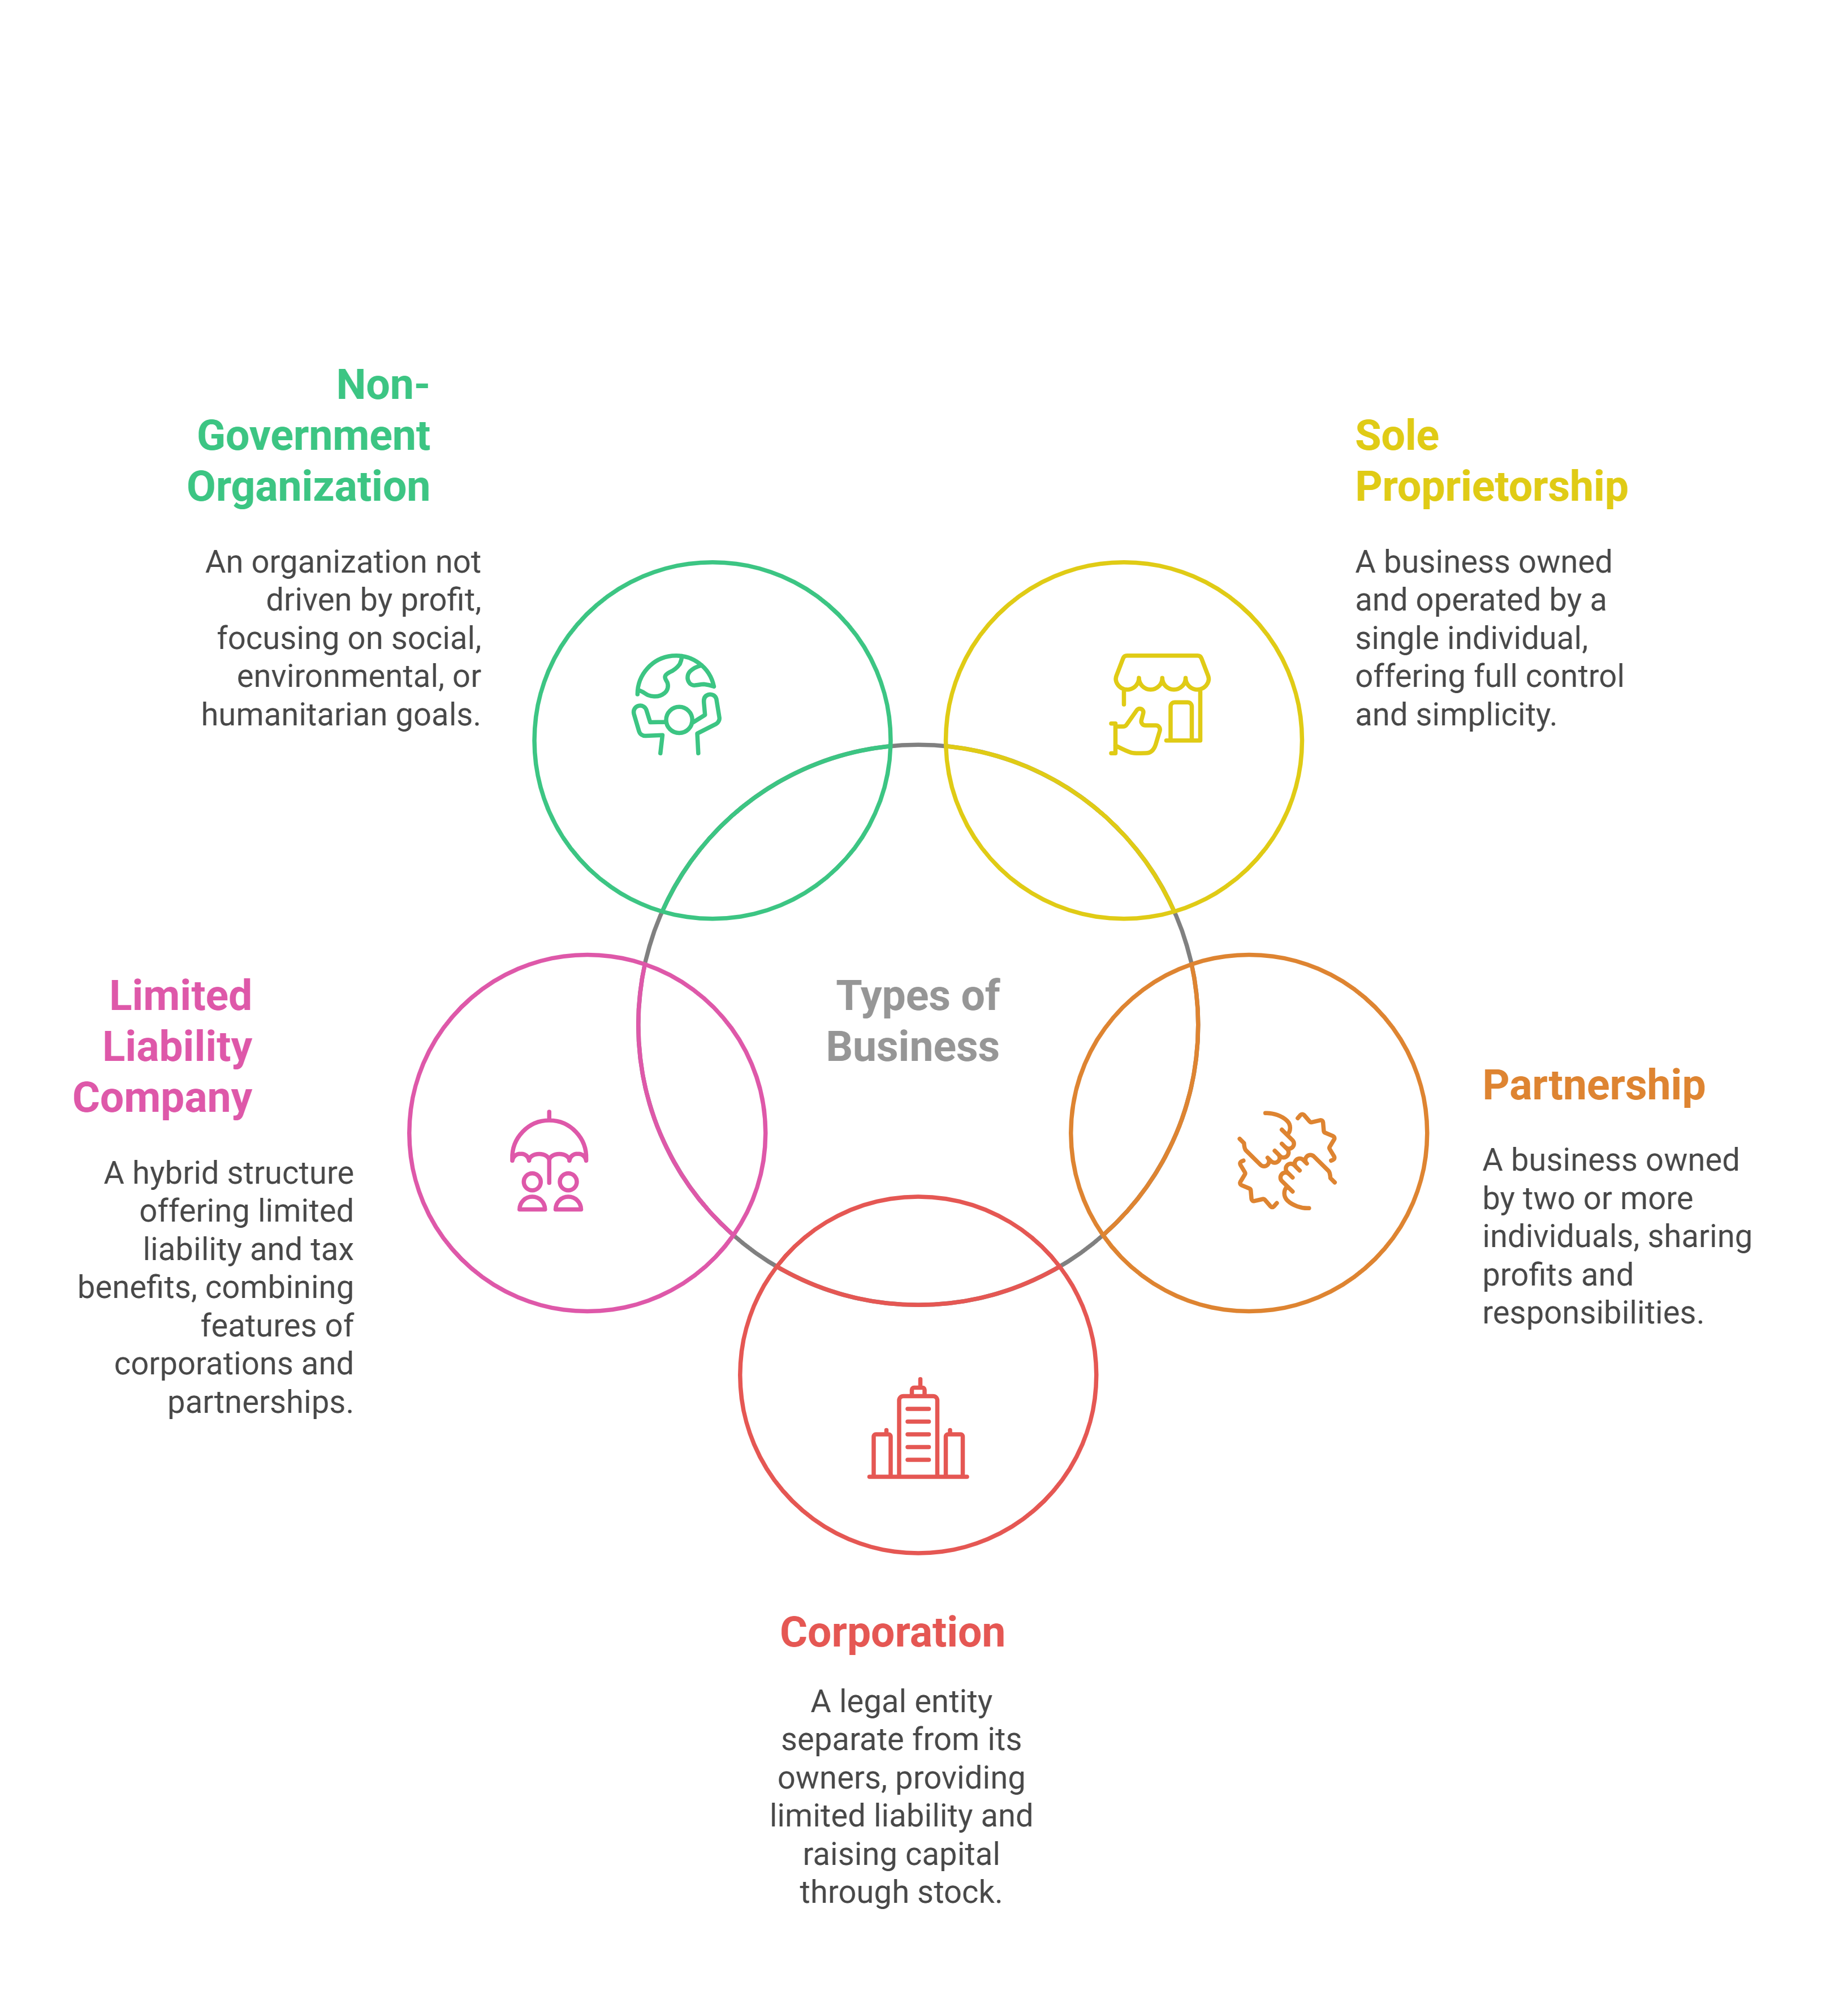

Slide 5
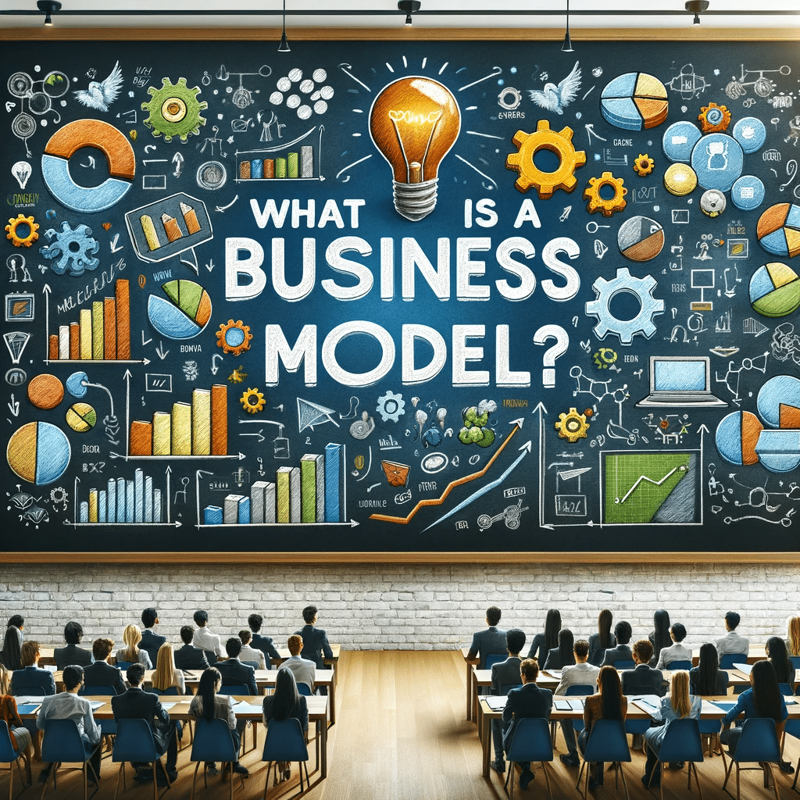
02.
Business Model
A business model is a plan for how a company creates, delivers, and captures value, detailing its strategy for making money and sustaining itself.

Slide 6
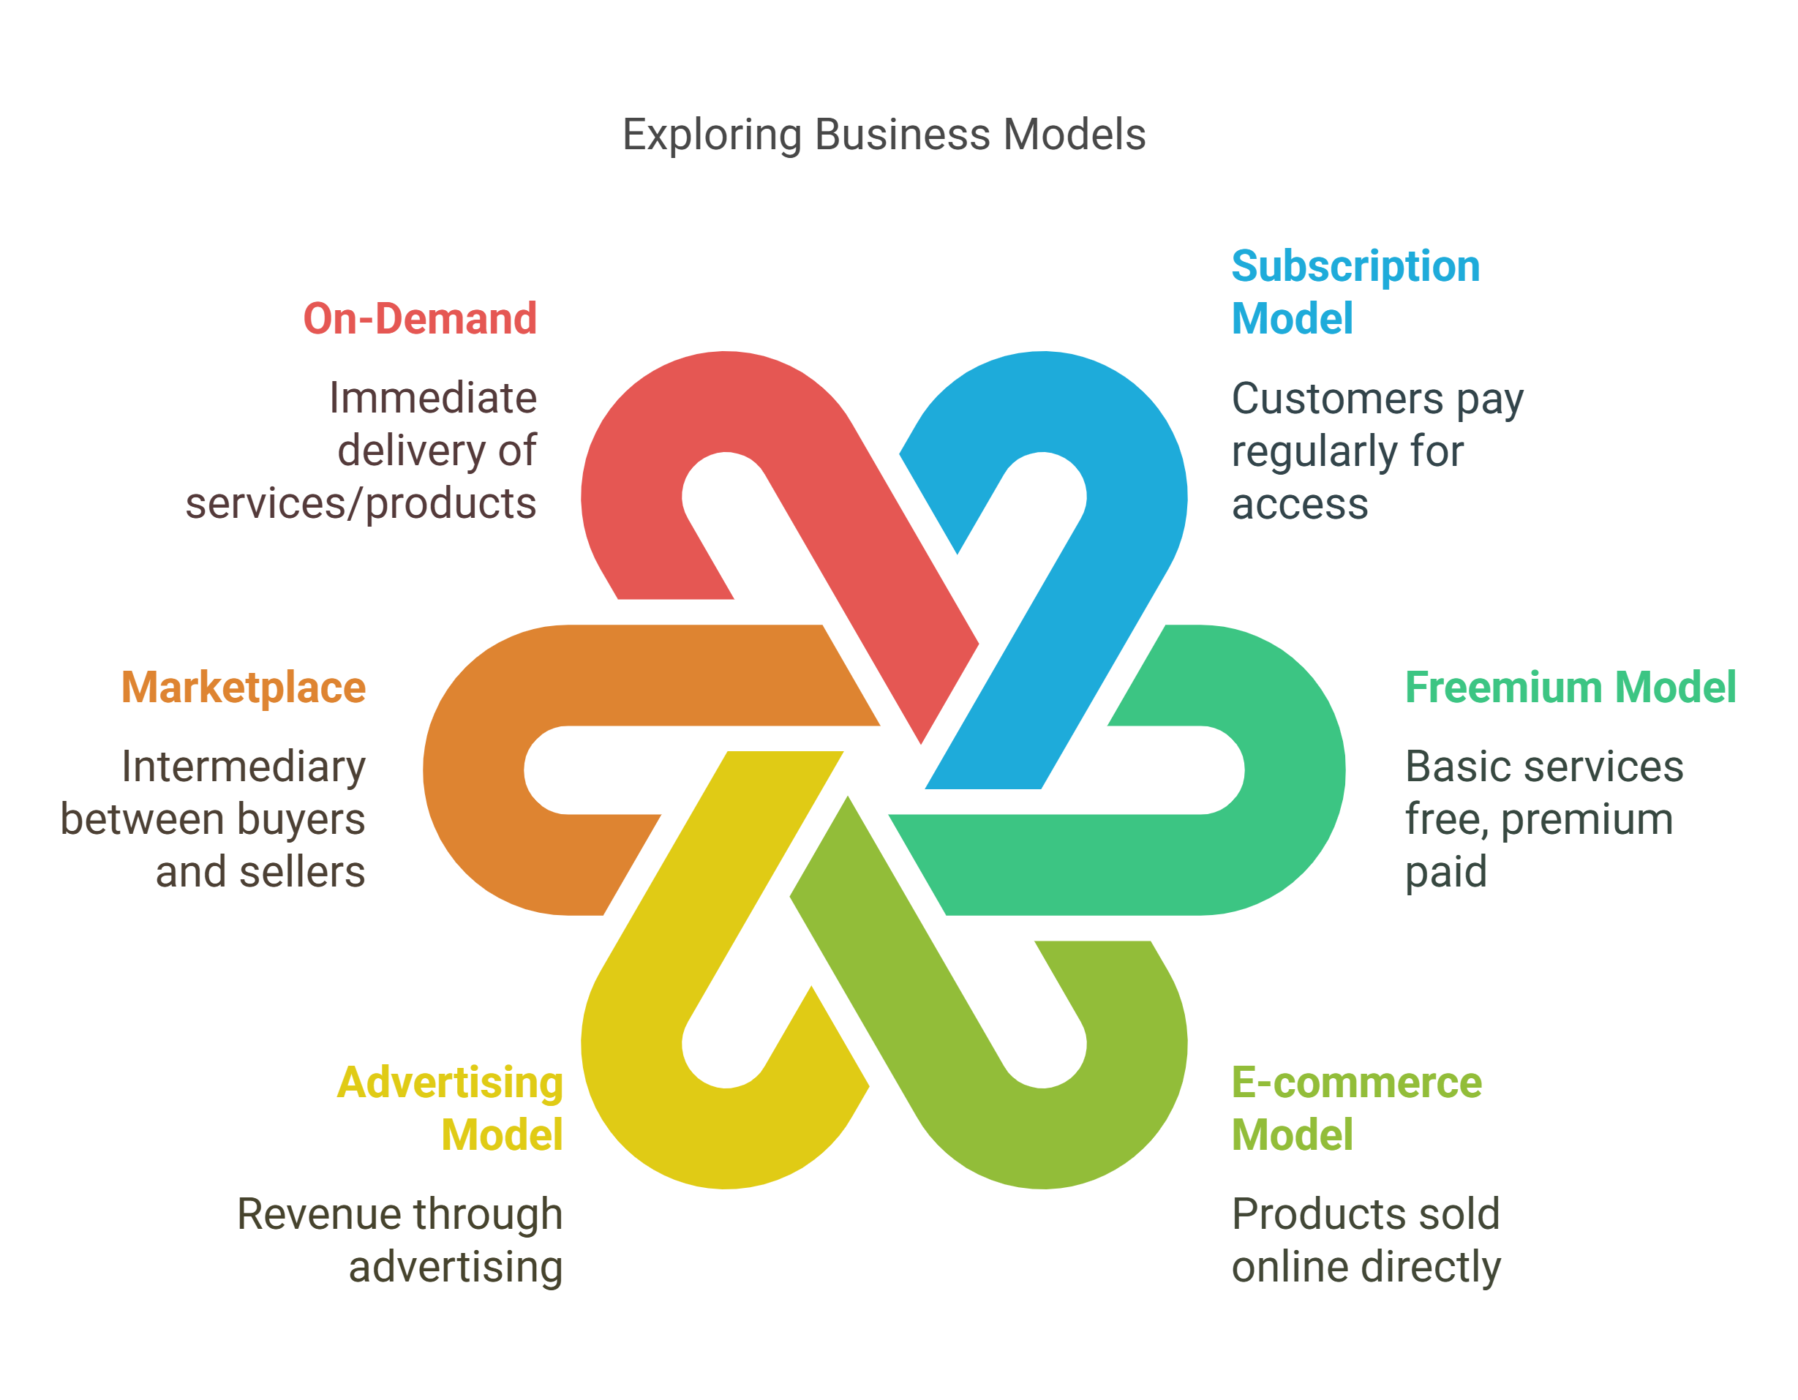

Slide 7
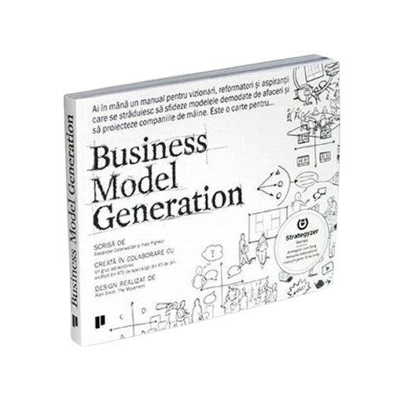
03.
Business Model Canvas

Slide 8
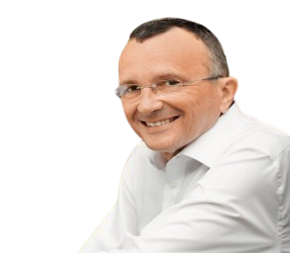
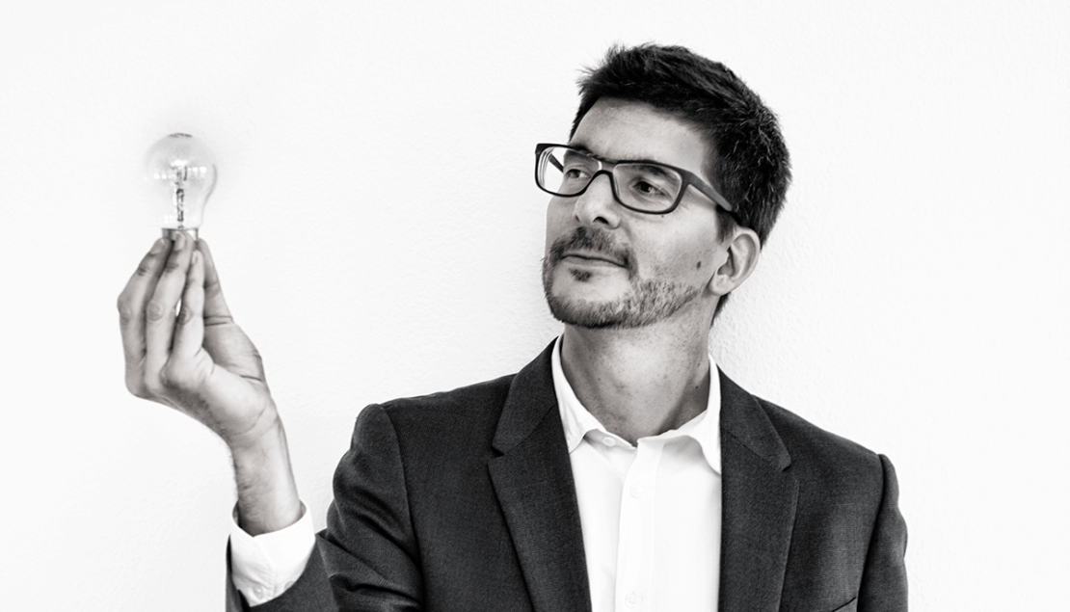
Alexander Osterwalder
Yves Pigneur
Alexander Osterwalder is a Swiss business theorist, author, speaker, consultant, and entrepreneur.
In his Book - "Business Model Generation" in 2010.
Yves Pigneur is a Belgium computer scientist, and Professor of Management Information System at the University of Lausanne .
He also authored books like Value Proposition Design, and The Invincible Company.

Slide 9
Business Model Canvas
The Business model canvas is a strategic management template used for developing new business models and documenting existing ones.
The Business model canvas is divided into nine essential building blocks that collectively describe how a business creates, delivers, and captures value.
The Business Model Canvas serves as a visual chart that facilitates a clear and structured discussion about business model design, allowing for easy adjustments and iterations.

Slide 10
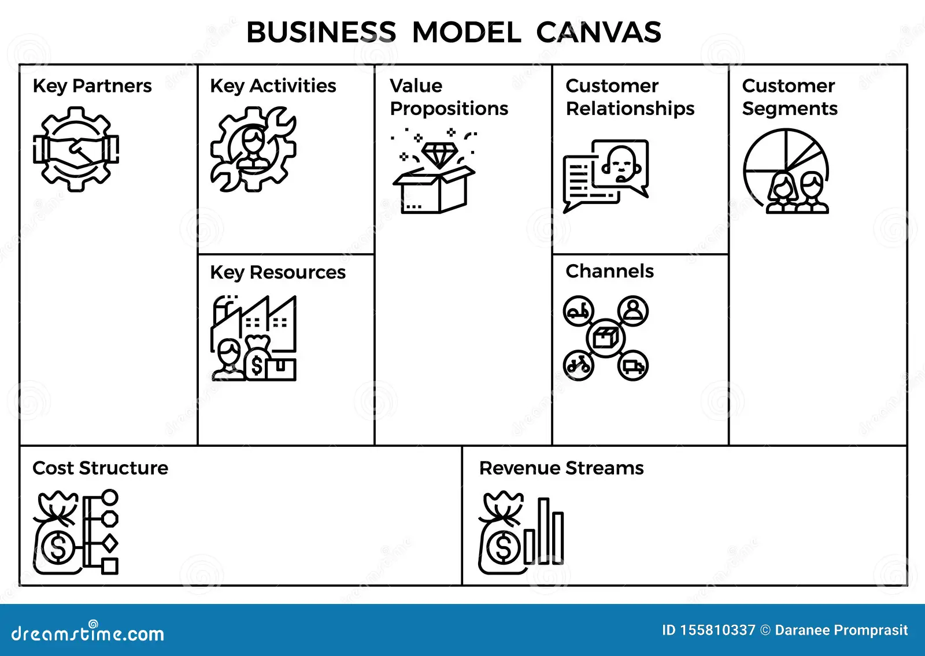

Slide 11









BUSINESS MODEL CANVAS
Identifies external collaborators for business success. E.g. Apple. | Describes tasks necessary to fulfill business objectives. E.g. Deloitte. | Describes unique solutions for customer problems. E.g. Tesla |  | Identifies different customer groups and their needs. E.g. Amazon
 | Lists essential inputs needed for business operations. E.g. Uber.
Analyzes costs associated with operating the business. E.g. Tesla |  | Details sources of income from products or services. E.g. Google
KEY ACTIVITIES
CUSTOMER RELATIONSHIPS
VALUE PROPOSITIONS
CUSTOMER SEGMENTS
KEY PARTNERSHIPS
Focuses on building loyalty and engagement with customers.
E.g. Tata Motors
KEY RESOURCES
CHANNELS
Outlines how to reach and communicate with customers.
E.g. Nike
COST STRUCTURE
REVENUE STREAM

Slide 12
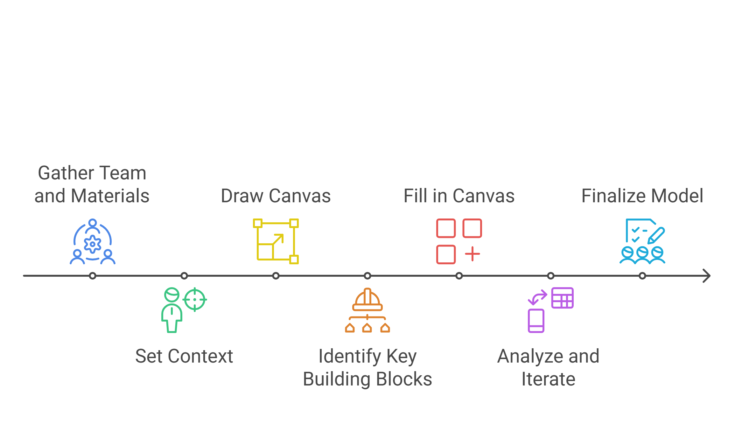
Steps to Implement Business Model Canvas

Slide 13

04.
Case Study

Slide 14
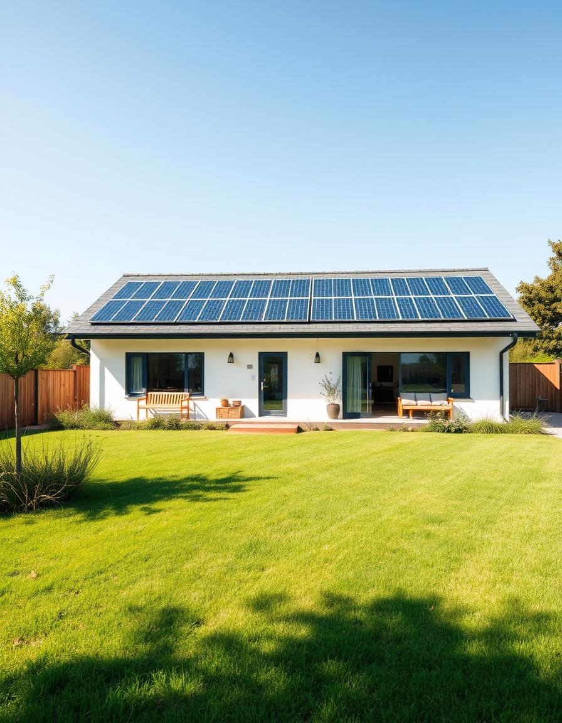
EcoHomes Case Study:
Achieving Sustainable Growth
Company Overview: EcoHomes is a mid-sized company focused on designing and building eco-friendly residential homes using sustainable materials and energy-efficient technologies.
Problem Statement​: Eco Homes is struggling to achieve sustainable growth and expand its market share, experiencing slow growth and facing challenges in increasing its market presence.

Slide 15
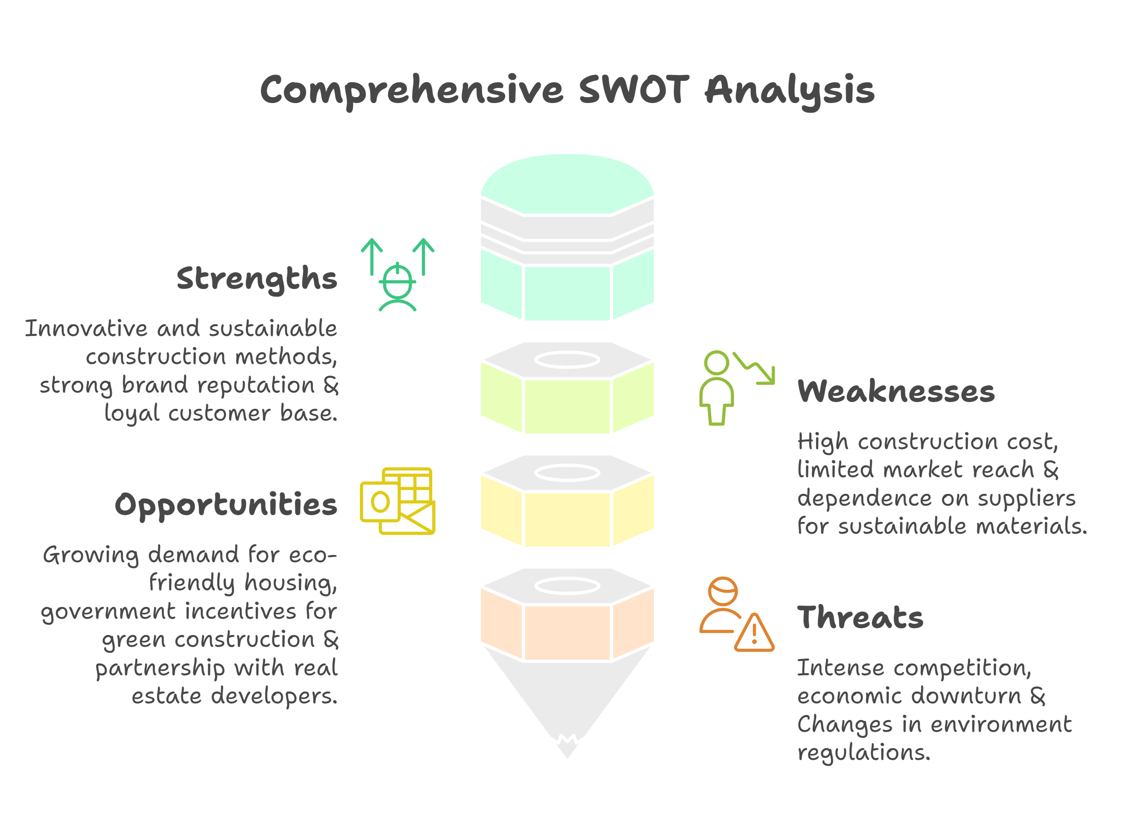

Slide 16
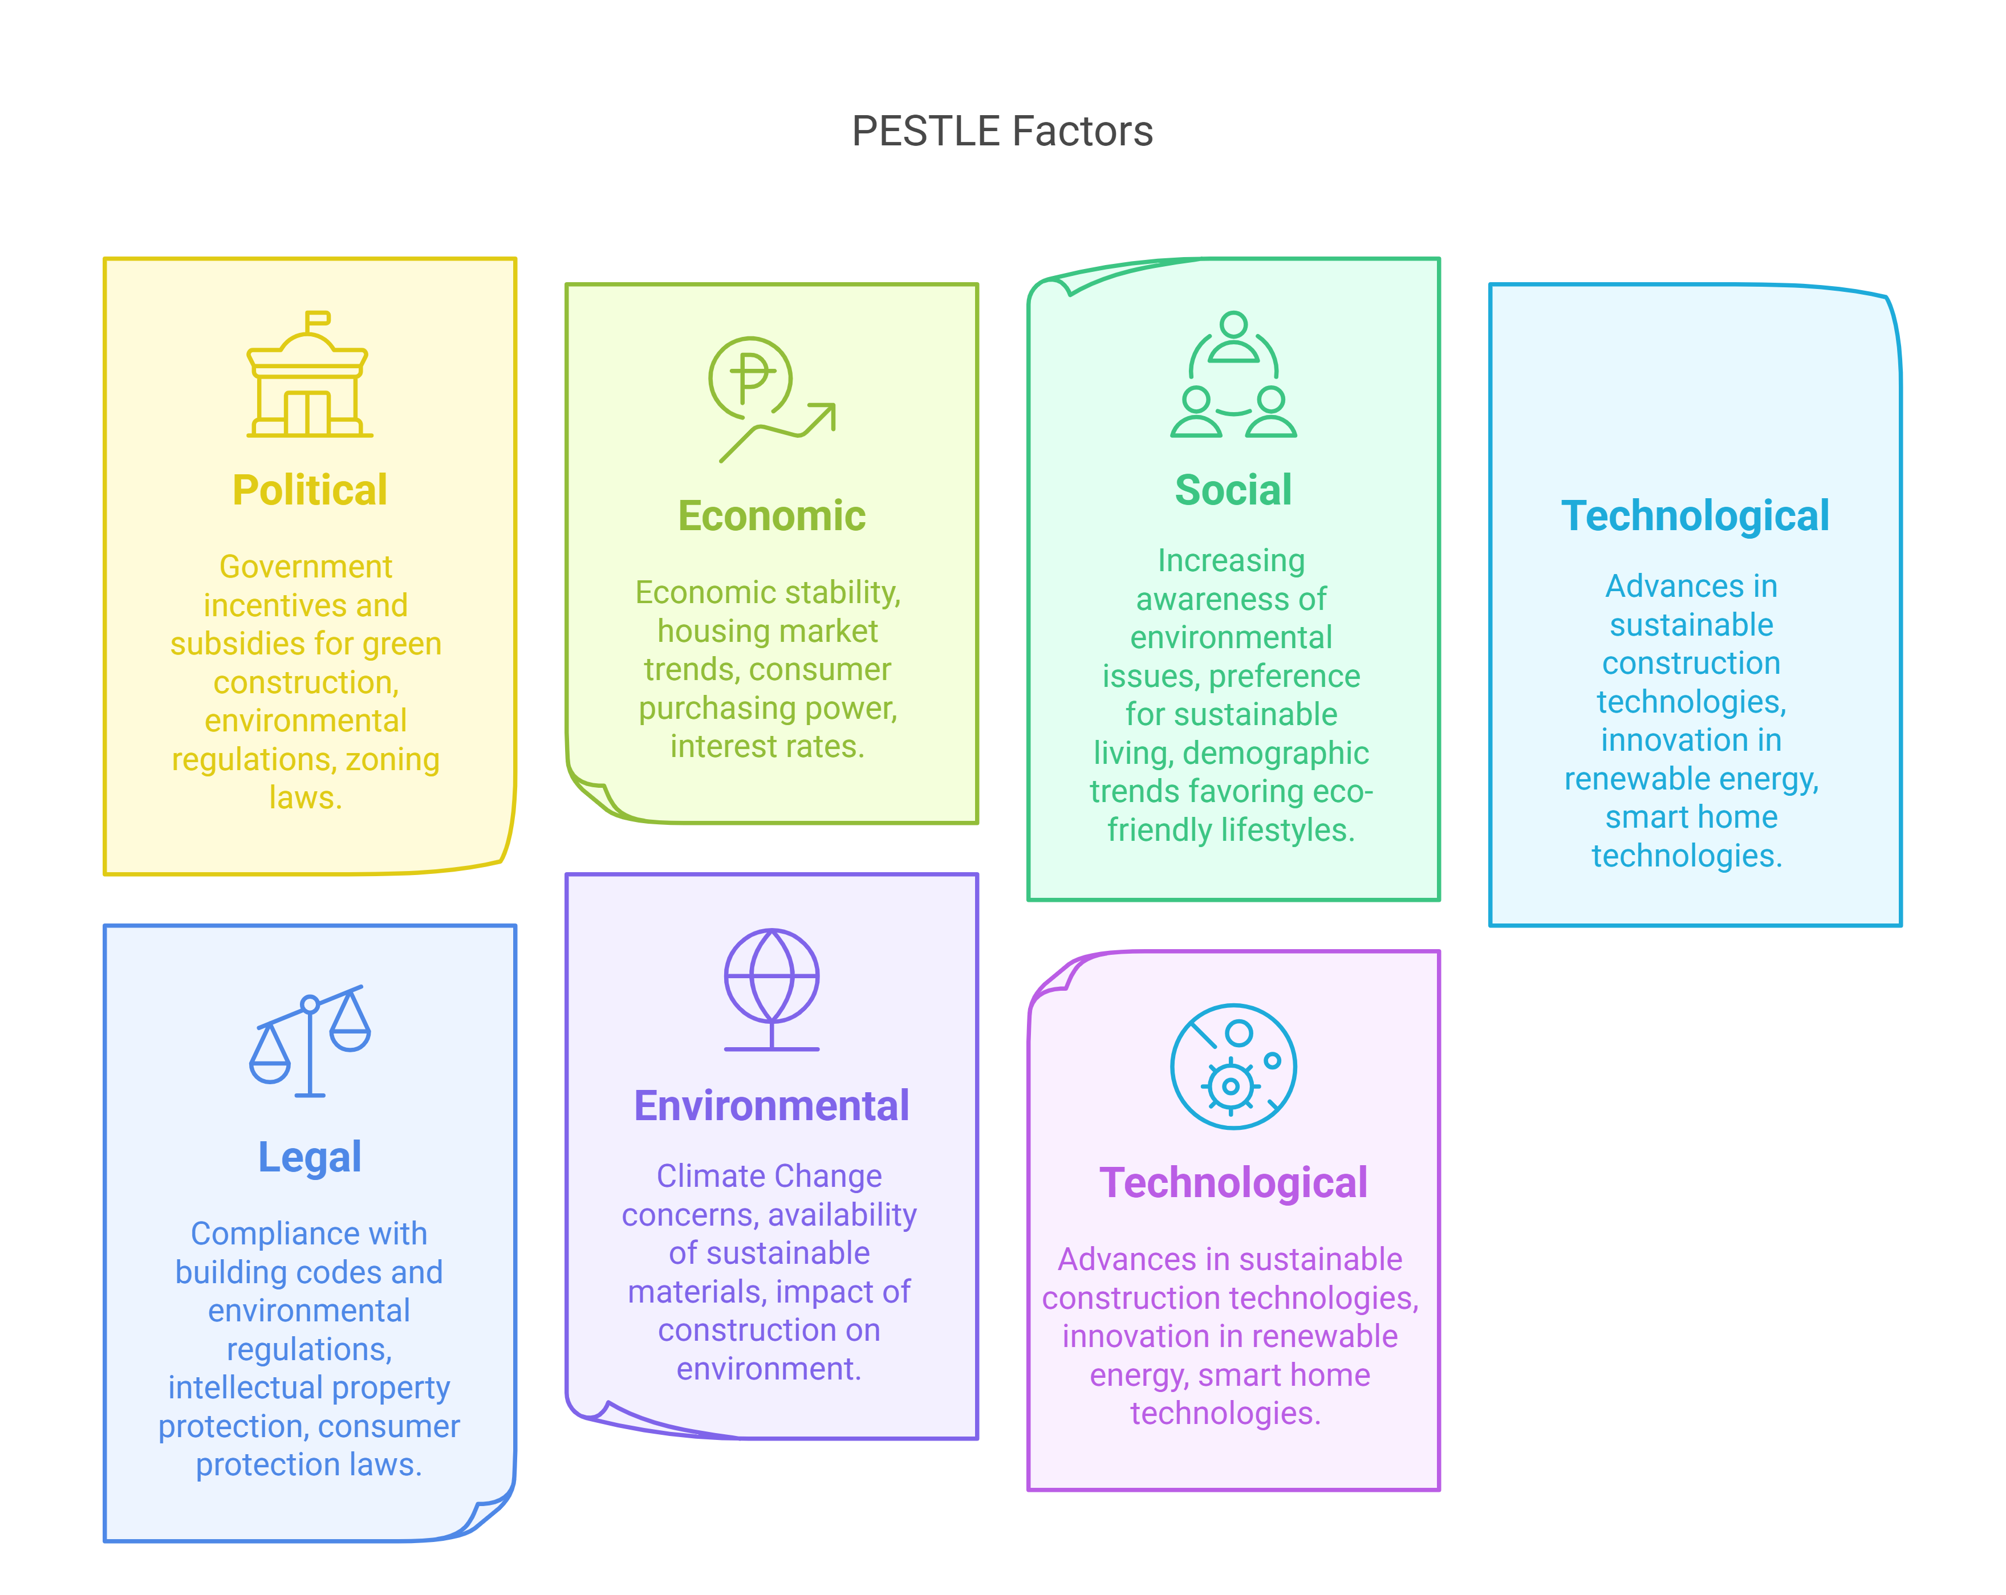
PESTEL Analysis

Slide 17
Business Model Canvas for EcoHomes
Suppliers of sustainable materials, renewable energy companies, real estate agents, environmental organisations. | Designing and building eco-friendly homes, marketing and sales, customer support. | Sustainable, energy-efficiency homes, reduced environmental footprints. |  | Environmental conscious homeowners, eco-friendly communities, real estate developers.
 | Sustainable building materials, skilled workforce, R&D for green technology, strong brand reputation.
Construction cost, R&D expenses, marketing and sales expenses, administration cost. |  | Sales of homes, consulting services for sustainable construction, maintenance contracts.
KEY ACTIVITIES
VALUE PROPOSITIONS
CUSTOMER RELATIONSHIPS
KEY PARTNERSHIPS
CUSTOMER SEGMENTS
Personalized customer service, educational workshop on sustainable living, loyalty programs.
KEY RESOURCES
CHANNELS
Direct Sales, partnership with real estate agents, online marketing, eco-friendly trade shows.
COST STRUCTURE
REVENUE STREAM

Slide 18
Balance Scorecard
Perspective | Objective | Key Performance Indicators (KPI'S) | Initiatives
Financial | Increase Profitability. | Profit margin, revenue growth, cost savings. | Optimize supply chain, reduce construction costs, explore new revenue streams.
Customer | Enhance Customer Satisfaction. | Customer satisfaction score, repeat business rate. | Improve customer support, offer workshops on sustainable living.
Internal Processes | Improve Customer Efficiency. | Project completion time, defect rate. | Streamline construction processes, invest in employee training
Learning & Growth | Foster innovation and employee development. | Number of new product/services, employee training hours | Invest in R&D, provide ongoing training for employees

Slide 19
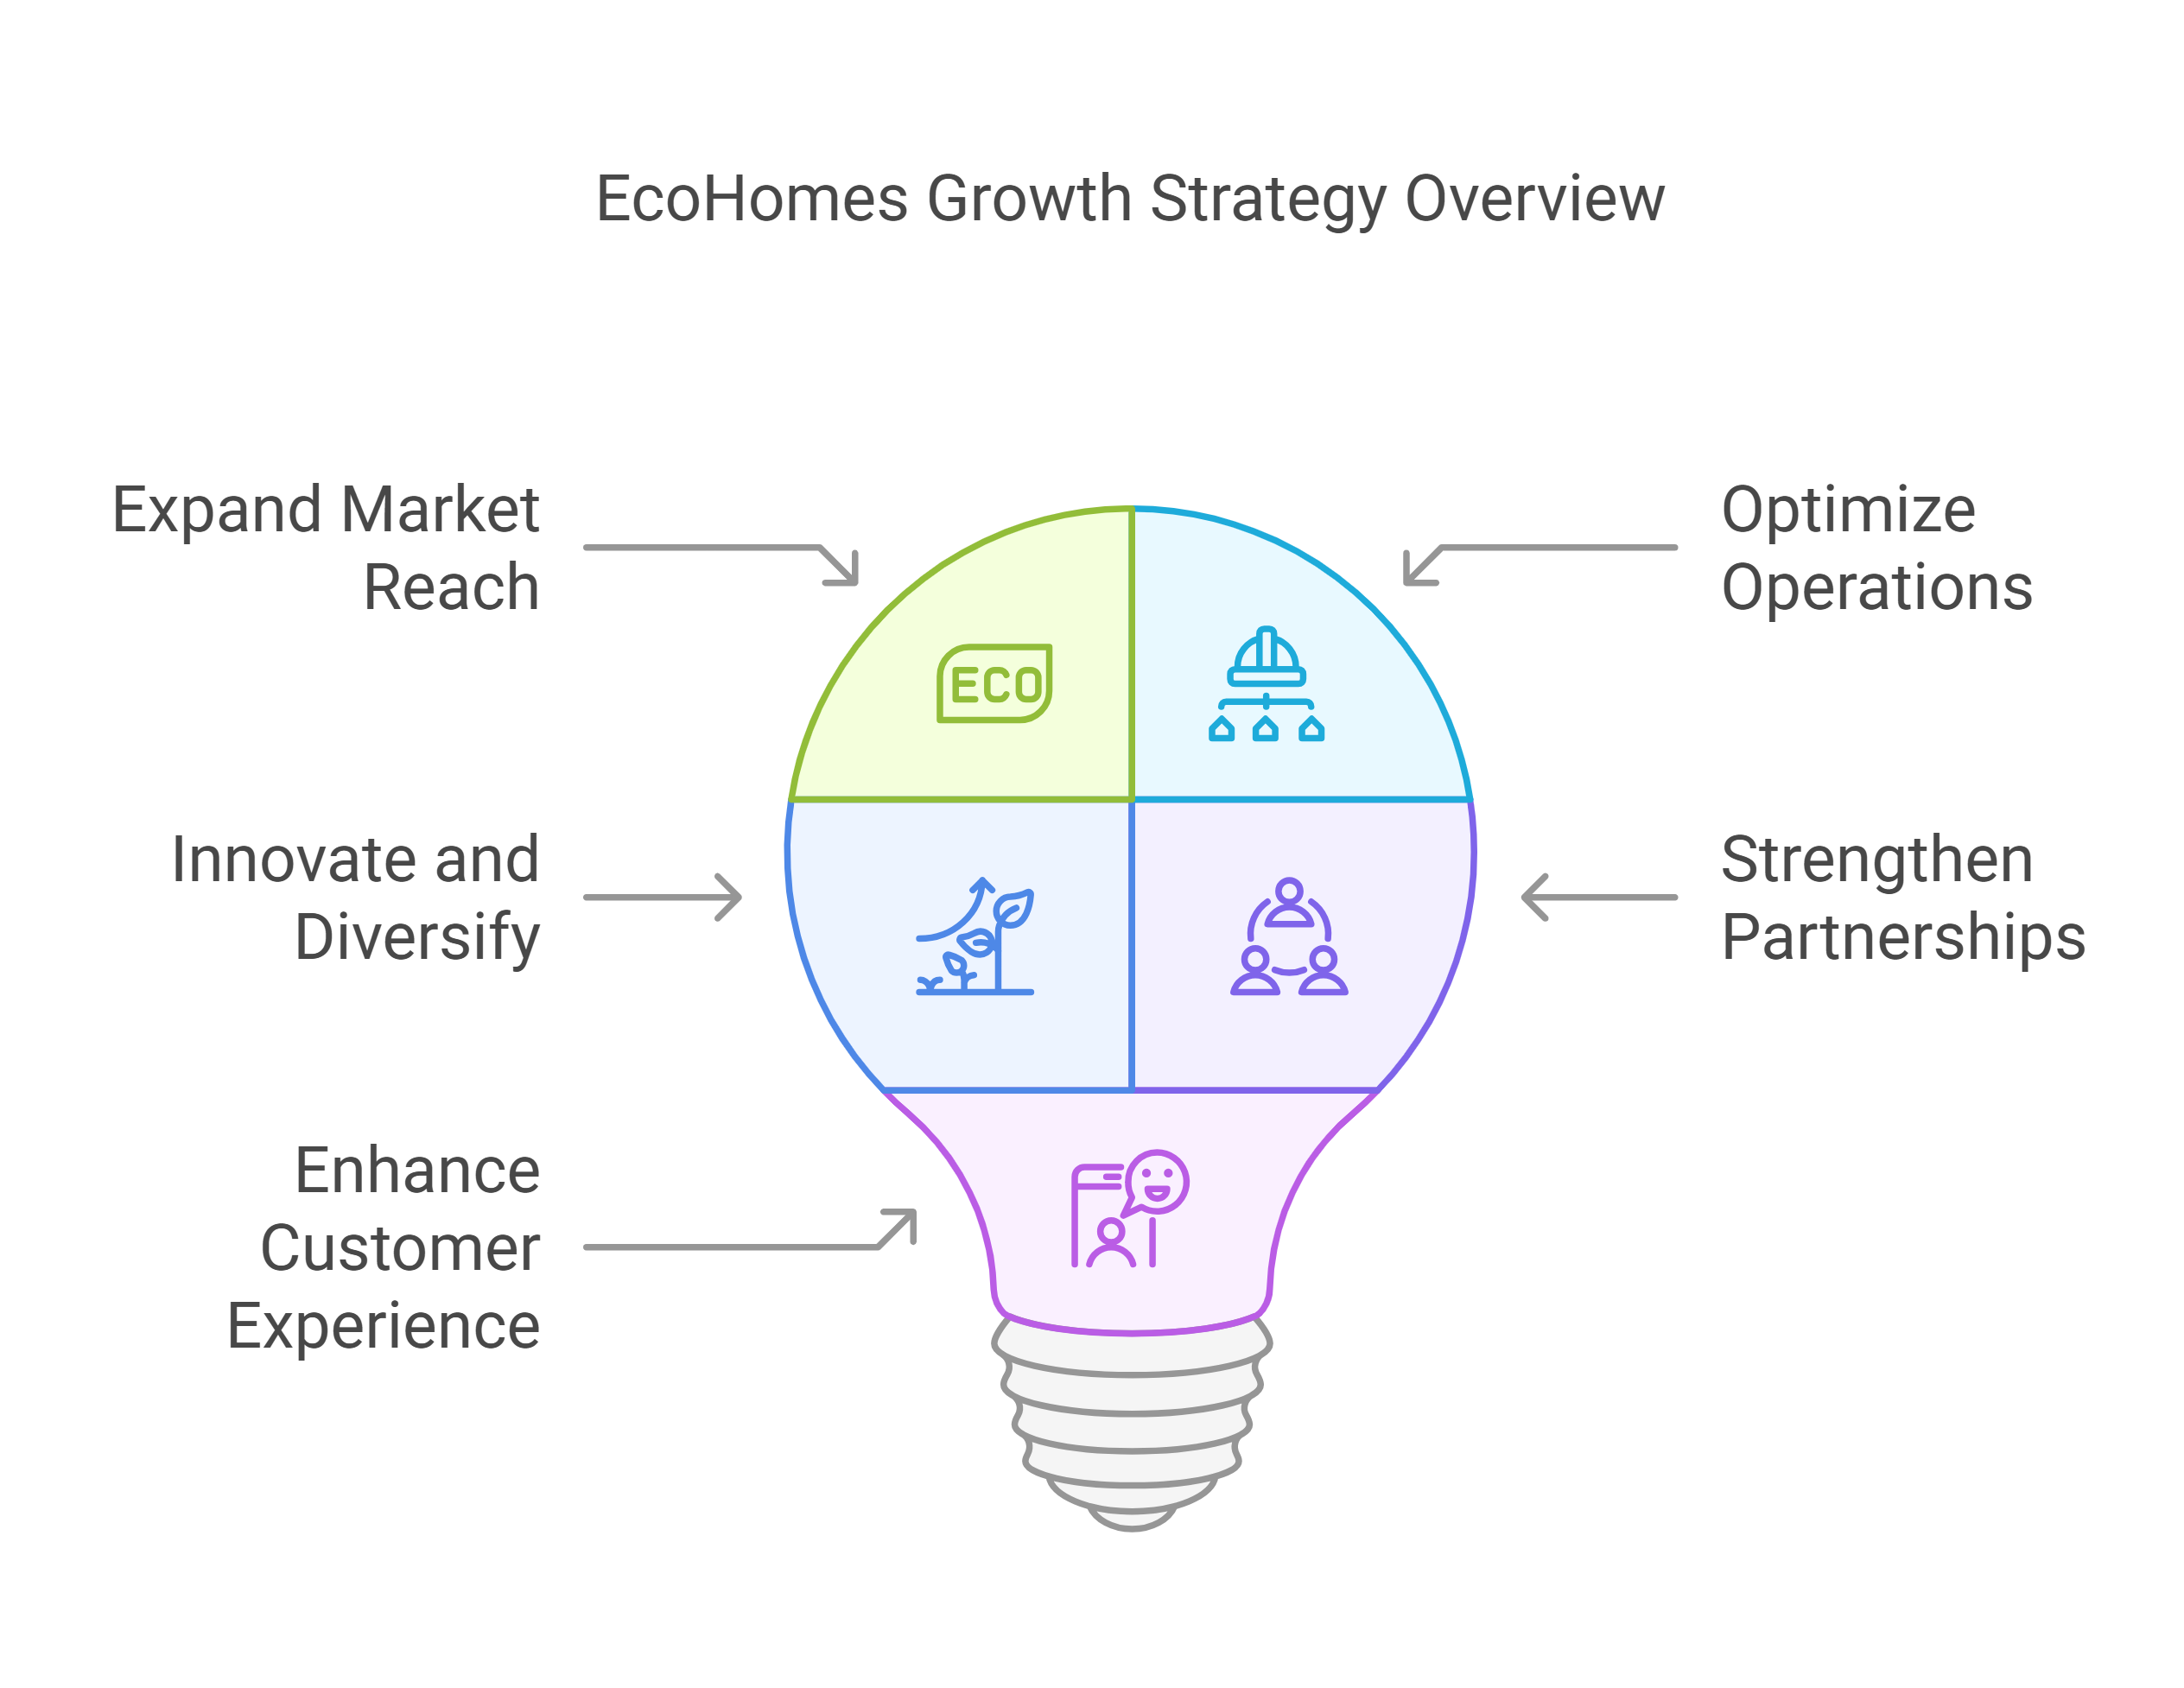

Slide 20
THANK YOU

